Slide 1

Z.O.O
Jiaziruo Sun, Shuheng Wang, Xiaoman Lin, Xinyin Zhang

Slide 2
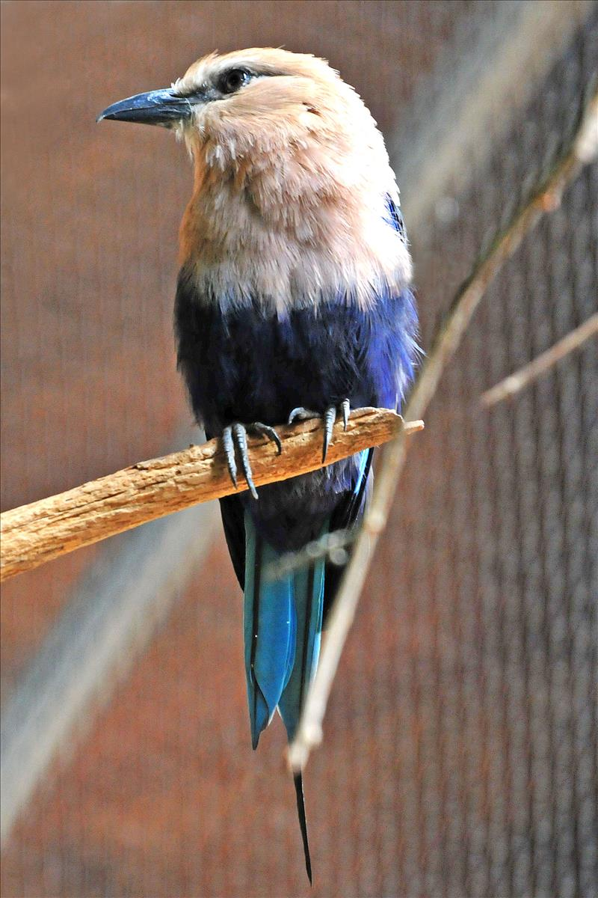
What are we creating? Why?
Create a systematic database “Z.0.0” for Tonronto Zoo, the largest zoo in Canada
Store and update animals’ and employees’ archives
Track visitors’ information and booking state
Image from torontozoo.com

Slide 3
Entities
Employee
Trainer
Security
Technician
Cleaner
Animal
Africa
Americas
Australasia
Canada Domain
Indo-Malaya
Department
Service
Camping
Gift shop
Scenic Safari Drive thru
Walking route
Visitor
Payment method
Cash
Credit
Debit
Ticket (weak entity)

Slide 4
Attributes
Employee
Name (composite)
First name
Middle name
Last name
Birthday (composite)
Year
Month
Day
Address (composite)
Street name
Street number
Postal code
Contact information (composite)
Email
Phone number
Salary
Age(derived)
Gender
ID (key)
Job_type
Department
Department code (key)
Phone
Technician
DeptinCharge
Trainer
AnimalinCharge
Security
AreainCharge
Cleaner
CleanArea

Slide 5
Attribute
Animal
Name
Age
Sex
Species
Preference (multivalued)
Diet
Environment
Domain
Quantity(derived)
ID (key)
Africa
AfricanCountry
Americas
AmericanCountry
Australasia
Aus_Area
Canada_Domain
province
Indo-Malaya
IM_Area

Slide 6
Attributes
Service
Opening hours (multivalued)
Phone number
Service Num (key)
Camping
Camping_area
Walking_Route
Route_name
Gift_shop
location
Scenic_Safari_Drive_thru
drive_route
Visitor
Name (composite)
First name
Middle name
Last name
ID (key)
Age (derived)
Ticket
Price
Ticket ID (key)
Overdue date (composite)
Day
Month
Year
Type

Slide 7
Attribute
Payment method
Credit
Credit_id
Cash
amount
Debit
Debit_id

Slide 8
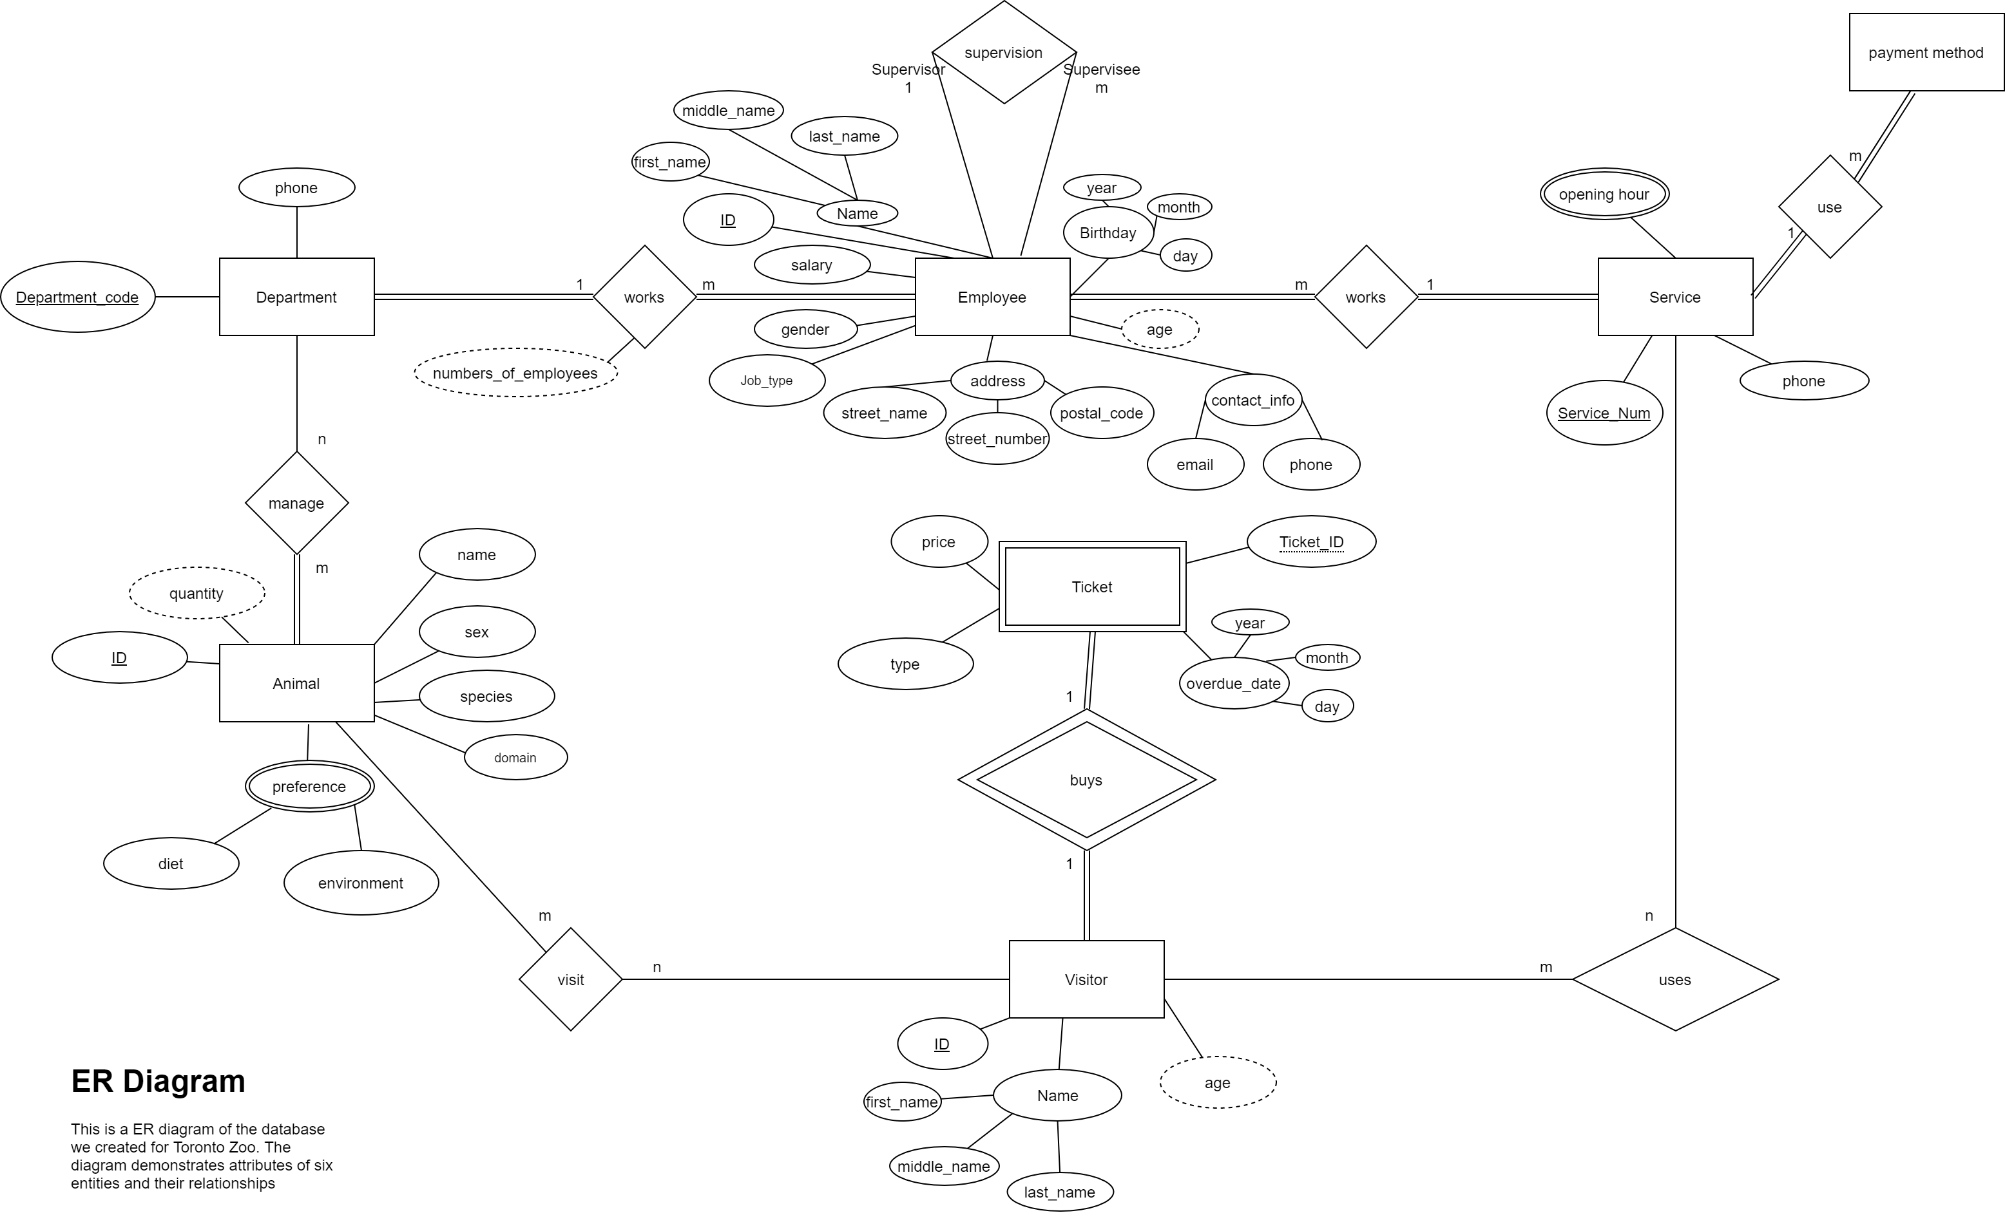
ER Diagram

Slide 9
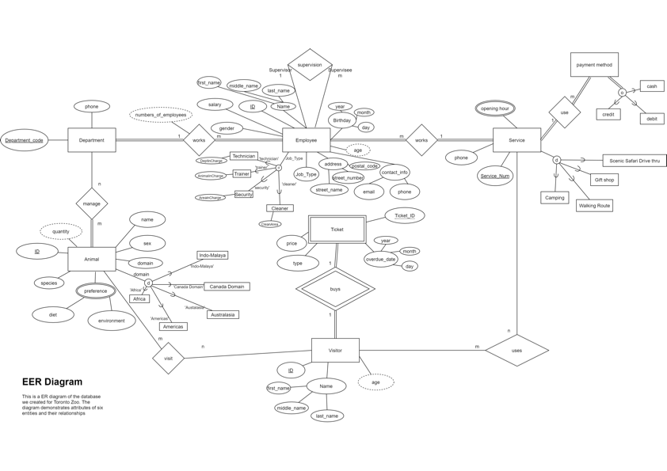
EER Diagram

Slide 10
Physical Database Design

Slide 11
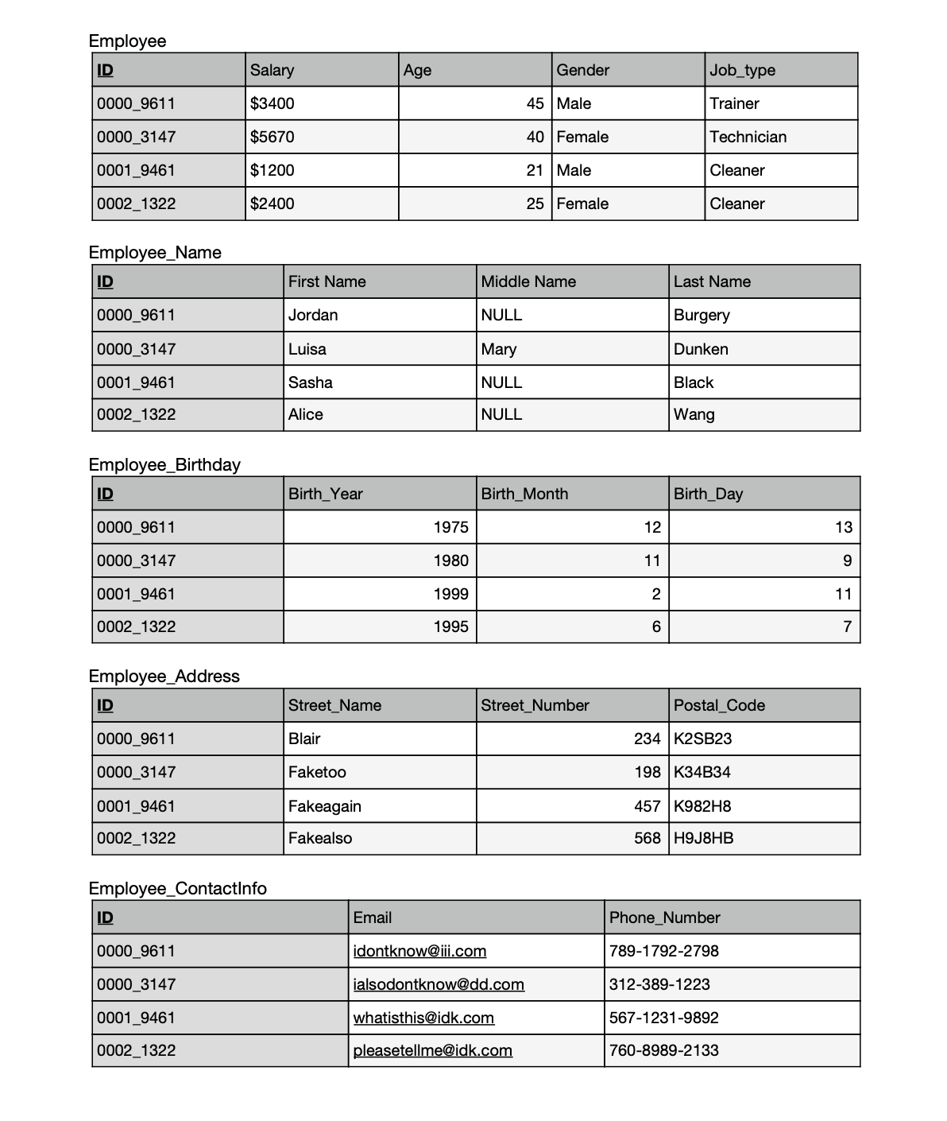
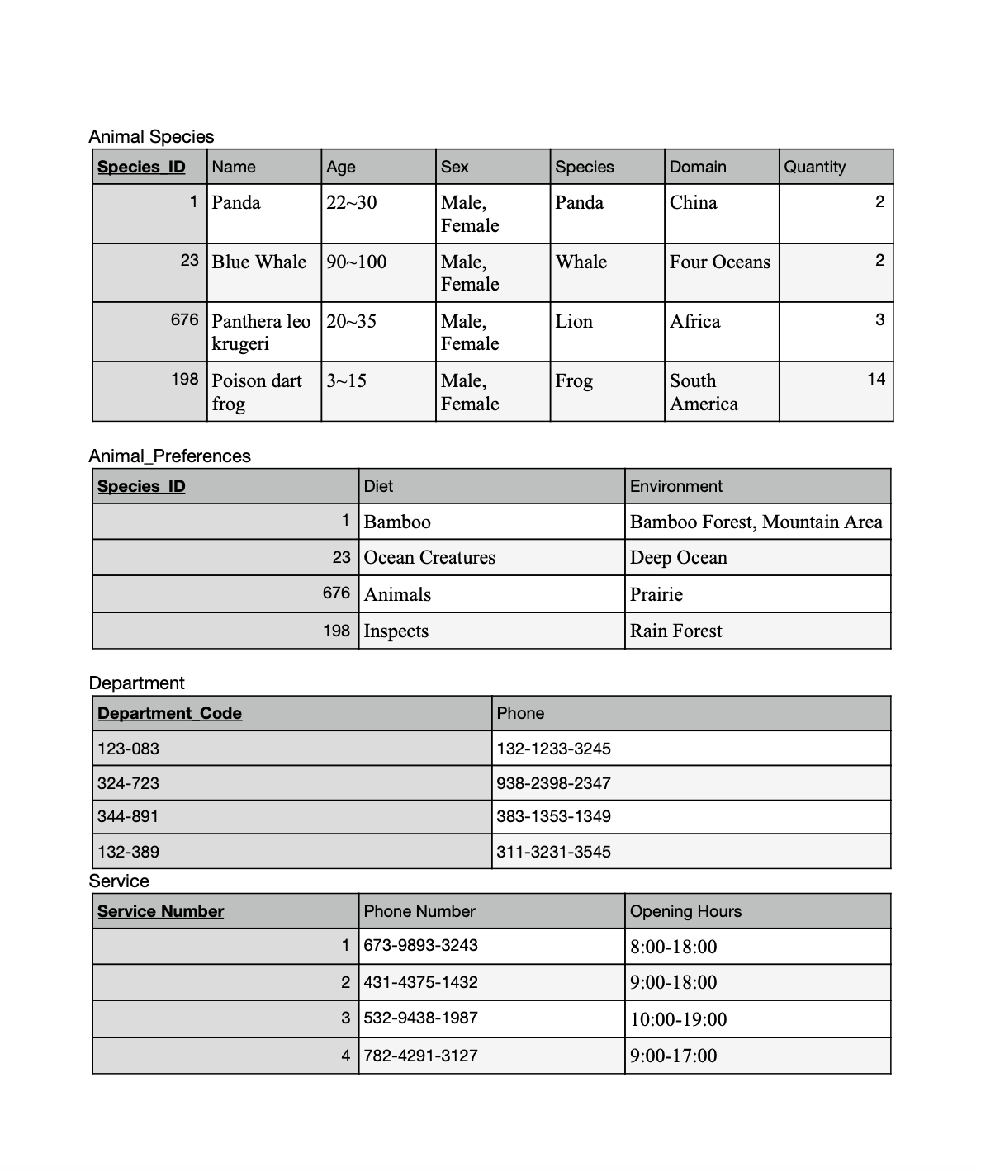
Normalization

Slide 12
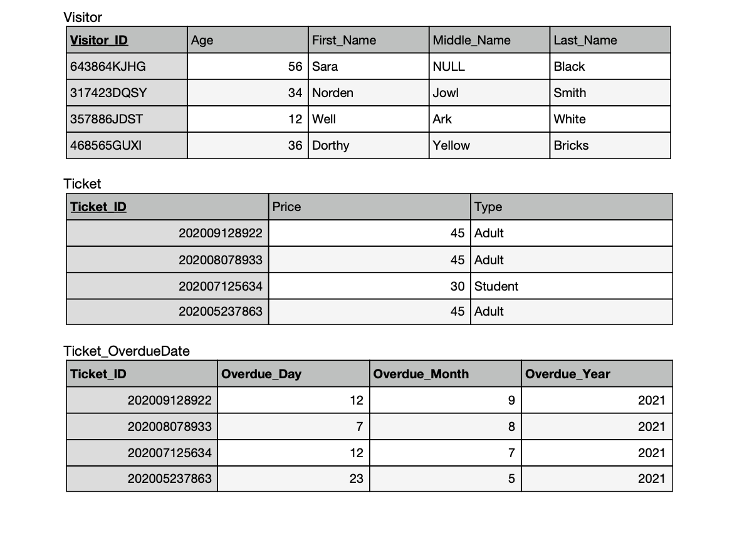
Normalization

Slide 13
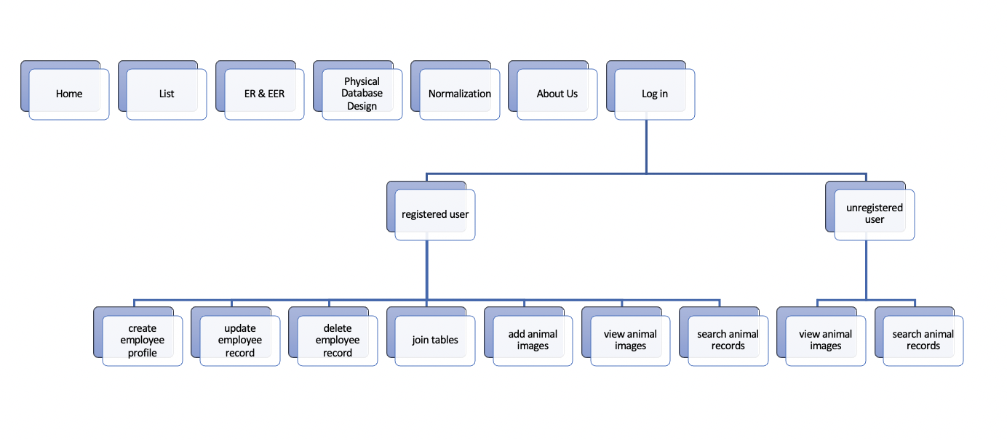
Final Website
Link: http://students.bitdegree.ca/~xinyinzhang/part4/Login.php
User info for testing: First name: Luisa Animal info for testing: Animal ID: 1
Last name: Dunken Animal Species: Panda
ID: 0000_3147 Animal Domain: China
Animal Name: Panda
Navigation tree:

Slide 14
Member Contribution
Jiaziruo Sun
Examine ER and EER diagrams
Design physical database (map binary 1:N relationship types, map binary M:N relationship types.)
Create SQL files for normalized tables
Create update and create record pages
Write reflection
Shuheng Wang
Conclude the project proposal
Examine ER and EER diagrams
Design physical database (map regular entity types, map weak entity types, map binary 1:1 relation types)
Create filled and normalized tables
Create navigation tree for websites
Create join table pages and view specific record pages
Write reflection

Slide 15
Member Contribution
Xiaoman Lin
List entities
Draw the ER and EER diagrams
Design physical database (map multivalued attributes, map specialization)
Create webpages (List, ER and EER, Physical Database, Normalization)
Create delete record pages and multimedia pages
Write reflection
Xinyin Zhang:
Create the report document and presentation
Examine ER and EER diagrams
Draw physical database design, stepbystep diagram, and demonstrate design process
Build the website skeleton, making homepage, menmber introduction page and Login page
Create SQL tables and make CSS
Create login/register pages
Write report and presentation PPT

Slide 16
Conclusion
Goal: build a manage system for Toronto Zoo to store and track information
Problem countered: -make choices of entities and attributs
-different time zones
-debug
-bad coding habit
How to solve: held online meetings and share screens while discussing, check each other’s code, review lecture recordings, write neat code,
Future problem: difficulty with extracting data, filtering data, programming, too much null values in the database
Future plan: avoid setting null value cells, be careful with naming variables and the consistency of variables

